Slide 1
ENCRYPTION AND DECRYPTION MACHINE
Project Work
Final Review
Project Guide:-
Mr. Jagtar Singh
Assistant Professor
SRM University
Submitted By:-
Divyam Dhadwal(186)
Divyank Vijay(149)
Bhanu Sankhyan(132)
B.Tech (C.S.E)

Slide 2
CONTENTS
Objective of the project
Introduction
Problem Description
3.1 Existing Problem
3.2 Proposed Methodology
3.2.1 Design Diagram
3.2.2 Detailed Description
4. Complete Implementation
5. Conclusion
6. References

Slide 3
1. OBJECTIVE OF THE PROJECT
To propose an algorithm for encryption and decryption of a piece of text by caesar cipher and polyalphabetic cipher.
Once the plaintext and key is added the corresponding ciphertext is produced. Similarly ciphertext and key produce the corresponding plaintext.

Slide 4
2. INTRODUCTION
This project is based upon the encryption and decryption of two types of ciphers - Caesar cipher and Polyalphabetic cipher. Both the ciphers are used by the various agencies to encypt their messages (the confidential data) . The encrypted text called cipher text is stored / sent.
A key is used as the chief component to encypt / decrypt a particular piece of text.Hence privacy of an user is improved by these means those can secure and don't ket any other person to use his / her confidential data.

Slide 5
3. PROBLEM DESCRIPTION
3.1 EXISTING PROBLEM:- There is a problem in conversion of plaintext into a particular cipher text under various input values of the key due to different ascii values of the elements when added with key, can result to unwanted and inappropriate results .
3.2 PROPOSED METHODOLOGY:- An algorithm will be proposed to convert the particular piece of plaintext into corresponding ciphertext using a particular key. Similarly an algorithm will be proposed to convert a particular piece of ciphertext into plaintext using key.Keys so used will be of wide range.

Slide 6
3.2.1 DESIGN DIAGRAM
Read the input from user of the choice : Encryption OR Decryption
Choose between caesar or polyalphabetic cipher
START
Choose whether to continue or quit.
Plaintext input by the user.
END
Output of the corresponding conversion is displayed
Key input by the user.
Result is saved in the particular string.
Algorithm for the corresponding conversion is performed

Slide 7
3.2.2 DETAILED DESCRIPTION
The steps involved in the algorithm includes:-
ALGORITHM FOR ENCRYPTION
(a) Plaintext is entered in form of string
(b) Split the characters in array of string
(c) Input the key from the user (numeric for caesar cipher and character for polyalphabetic caesar)
(d) String array of plaintext is traversed
(e) Corresponding array element is added to the corresponding key
(f) Arithmetic mod26 is applied to the result
(g) Corresponding ciphertext is produced
RESULT:- The result of above algorithm is encrypted text.

Slide 8
ALGORITHM FOR DECRYPTION
(a) Ciphertext is entered in form of string
(b) Split the characters in array of string
(c) Input the key from the user (numeric for caesar cipher and character for polyalphabetic caesar)
(d) String array of ciphertext is traversed
(e) Corresponding key element is subtracted from the corresponding array element
(f) Arithmetic mod26 is applied to the result
(g) Corresponding plaintext is produced
RESULT:- The result of above algorithm is Decrypted text.

Slide 9
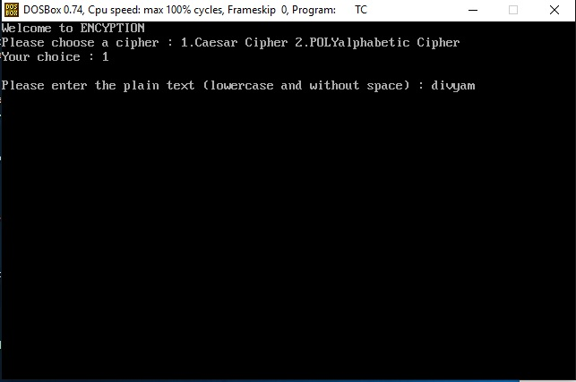
4. COMPLETE IMPLEMENTATION
CAESAR CIPHER:INPUT PLAINTEXT

Slide 10
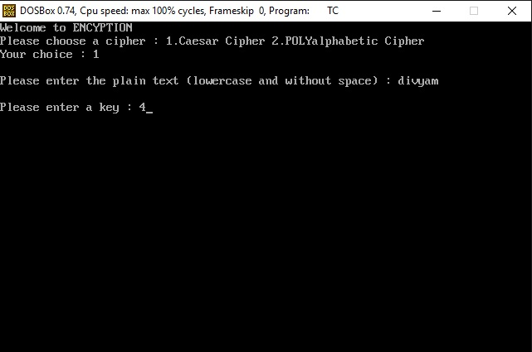
CAESAR CIPHER:INPUT KEY

Slide 11
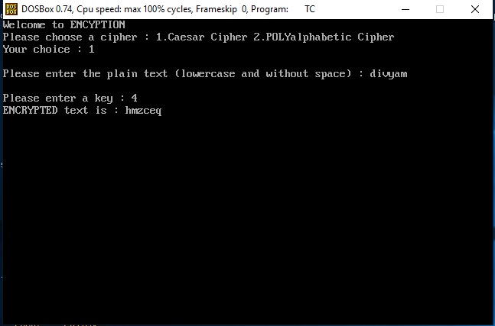
CAESAR CIPHER:ENCRYPTION

Slide 12
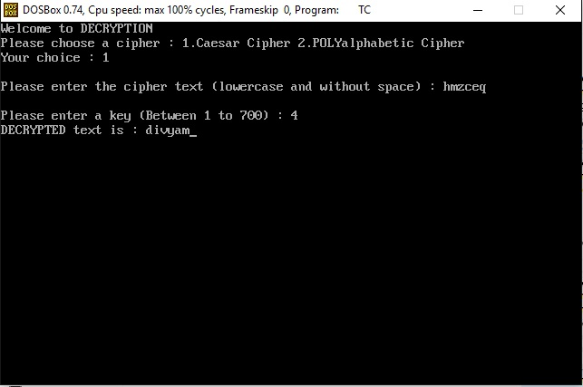
CAESAR CIPHER:DECRYPTION

Slide 13
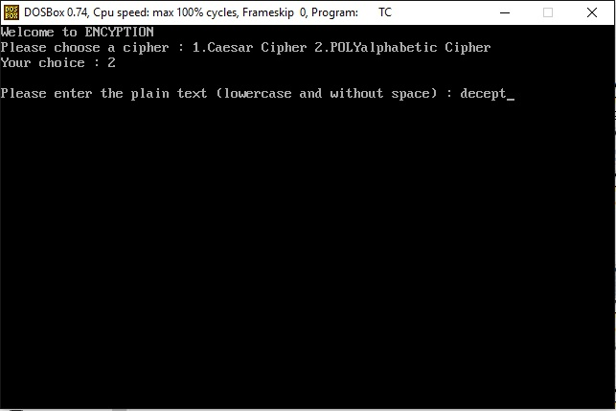
POLYALPHABETIC CIPHER:INPUT PLAINTEXT

Slide 14
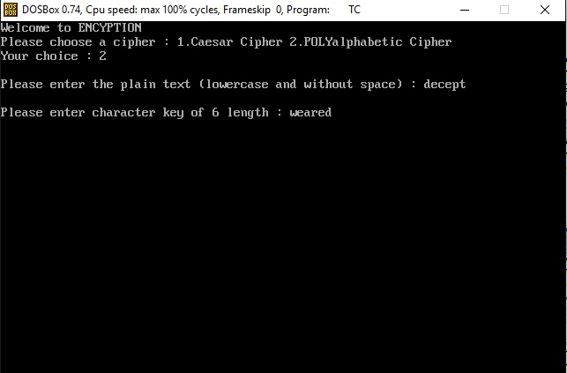
POLYALPHABETIC CIPHER:INPUT KEY

Slide 15
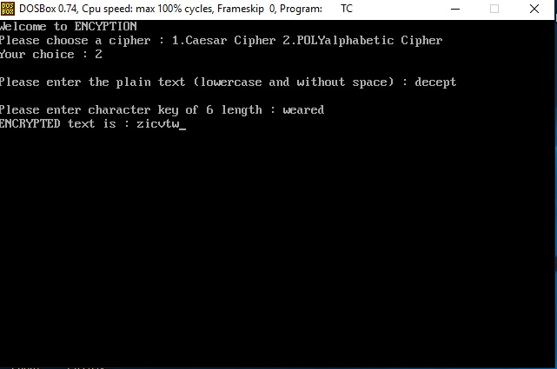
POLYALPHABETIC CIPHER:ENCRYPTION

Slide 16
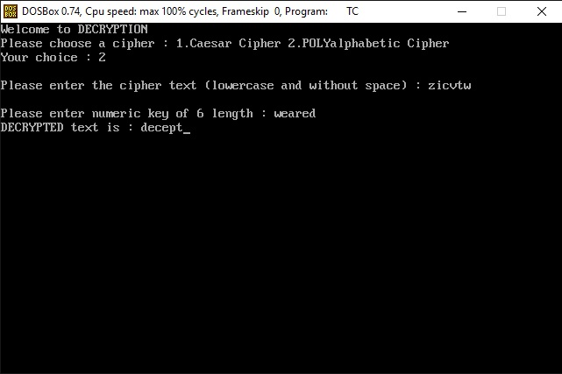
POLYALPHABETIC CIPHER:DECRYPTION

Slide 17
5.CONCLUSION
A main problem in encryption and decryption is that due to variation in ascii values of the characters the existing programs are unable to compute the correct results. Thus, an algorithm is proposed here which can easily perform encryption using two types of ciphers.
Also, an algorithm is proposed for decryption using two types of ciphers. The algorithm includes logic statements. This program may be used for encryption and decryption in future.

Slide 18
6. REFERENCES
[1]. Herbert Schildt,”The Complete Reference in C (4th edition),27th Reprint 2009”.
[2]. Herbert Schildt,”The Complete Reference in C++(4th edition),2009”.

Slide 19
THANK YOU !!

